Slide 1
QUANTUM CHESS
CS 319-2
Group 2A

Slide 2
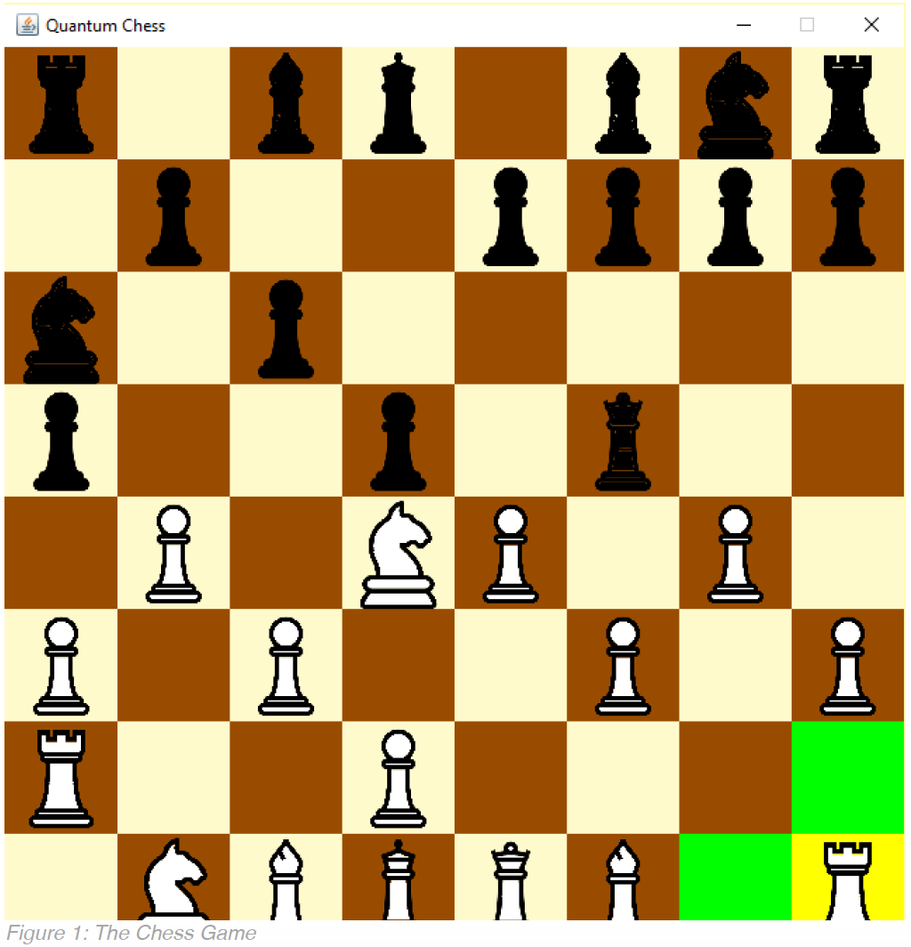
1) State of Developments
Creating play board
Implementation of each pieces and their locations on the board
1.3. Performing movements of pieces
1.4. Determination of collusion of pieces

Slide 3
2) Needs to Change
Putting visual tutorial
Demonstrating visuals is easier to comprehend for players
Giving some instructions to players to understand the complex rules of Quantum Chess

Slide 4
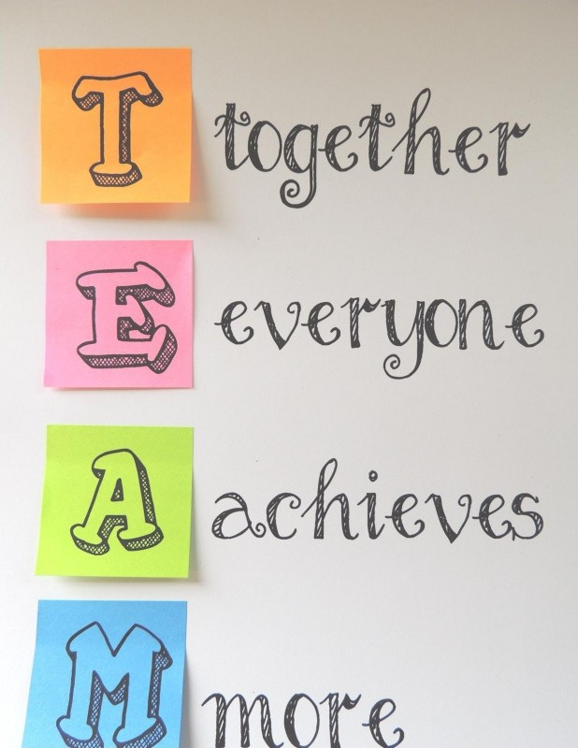
4) Lessons about Teamwork
Understanding how the cooperation is essential in projects
Improving social skills
Improve efficiency
Dealing with problems readily

Slide 5

Thanks for paying attention!

